Slide 1
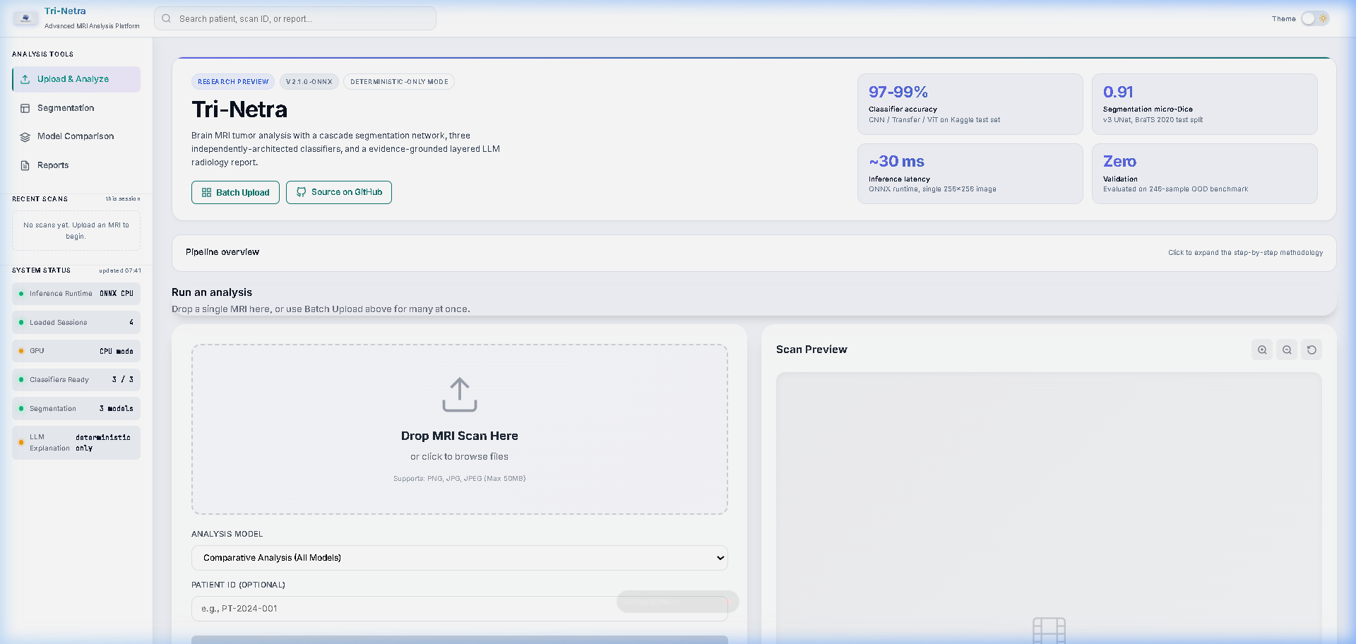
Tri-Netra AI
Advanced Brain Tumor Detection & Analysis
Anannya Vyas | Roll No. 9 | CCET, Chandigarh

Slide 2
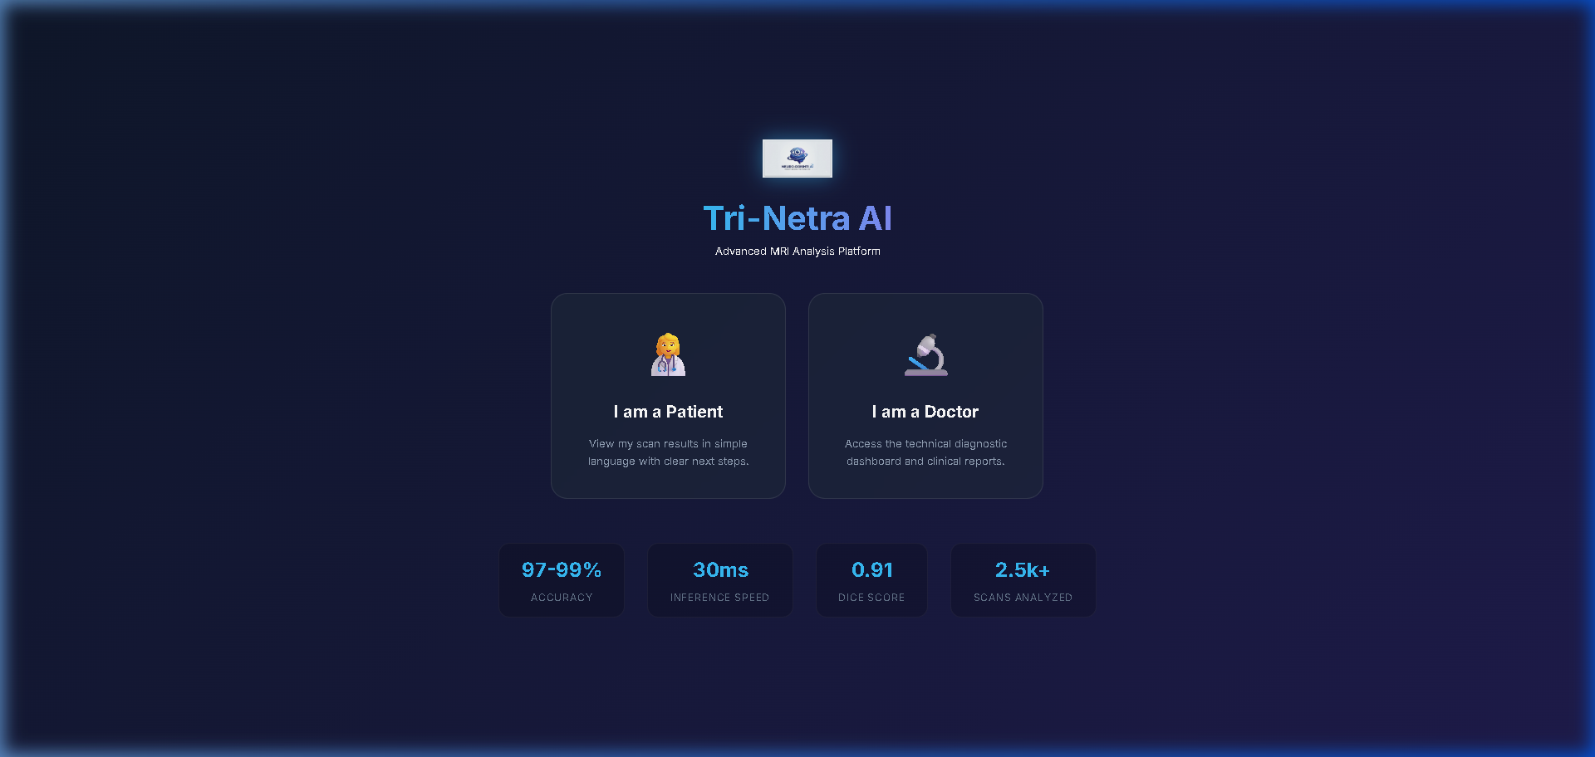
System Architecture & Blueprint

Slide 3
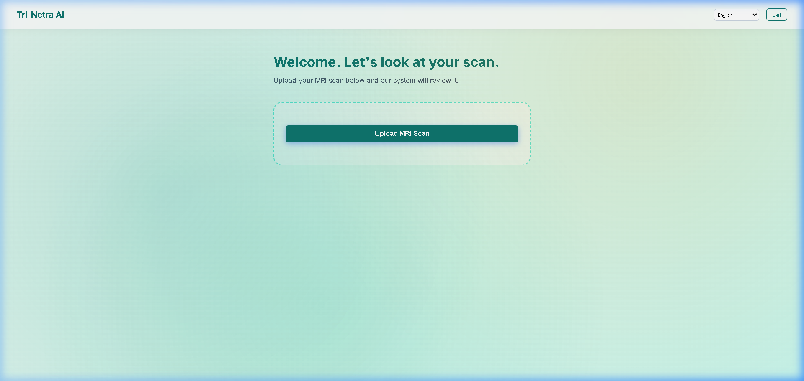
Patient Mode Interface
• Simplified risk scoring • Empathetic language • Multi-lingual AI Chatbot ("Neuro") • Reduces patient anxiety • Instant PDF report generation

Slide 4
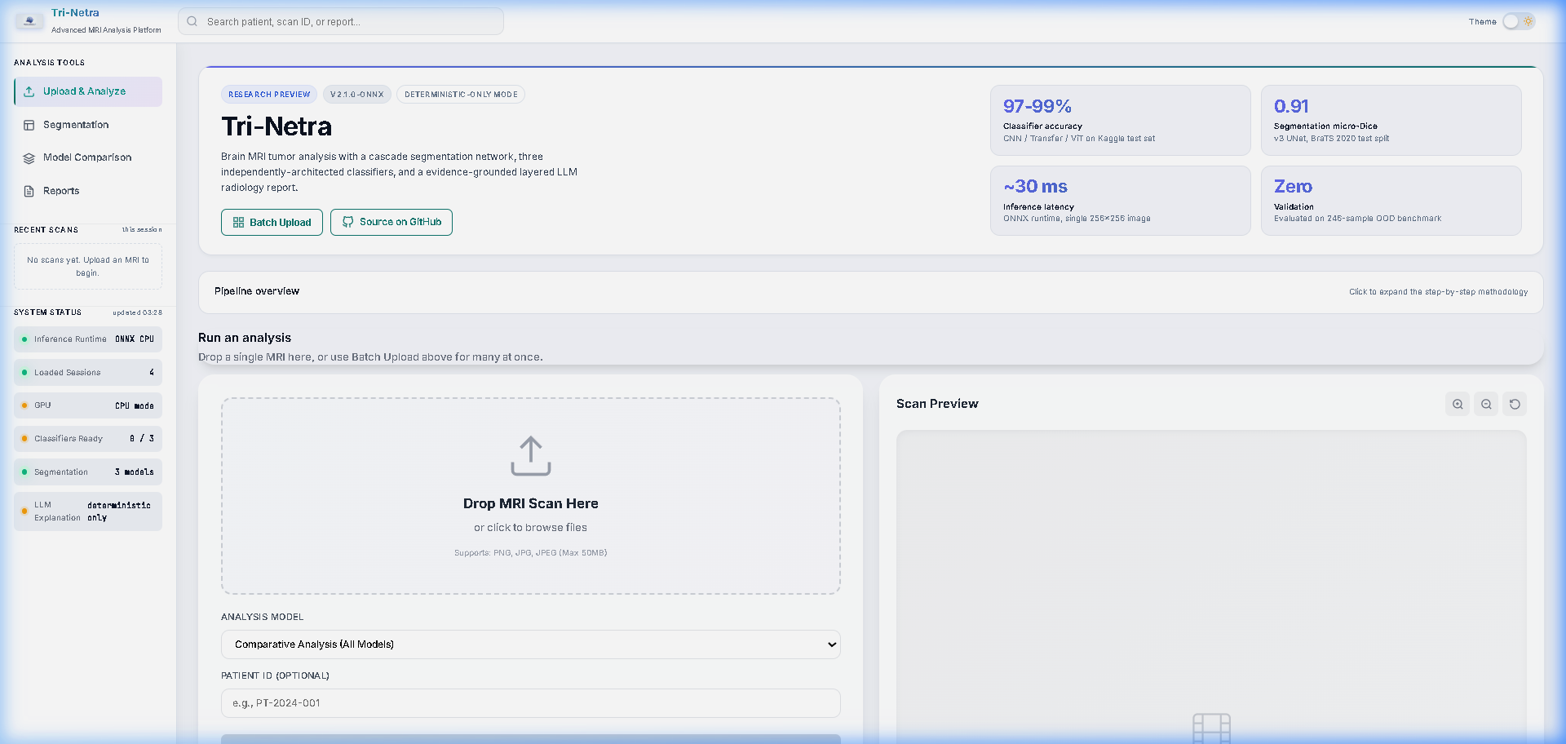
Doctor Mode & Clinical Dashboard
• Interactive Segmentation Overlays • 4-Signal Ensemble Confidence Tracking • Deterministic Feature Extraction • Layered LLM Zero-Hallucination Report

